Slide 1
Cell Counting in Microscopy Using
- CNNs -
BME3053C
Contributors: Kellyna Voyer, Jada Brown, Daniel Osorio, and Valery Fuhrer
Github Repository: https://github.com/DanielOsorio1/Final-Project.git

Slide 2
Project Overview
Objective: Develop a machine-learning model to detect and count cells in microscopy images.
Core Technology: Utilized our own automatic cell counting and identification system using a convolutional neural network (CNN).
Dataset: Leverage a Ground-Truth dataset of 1,200 images from the Broad Bioimage Benchmark Collection (BBBC), featuring cells in a grayscale to give consistent data to the CNN.
Training and Validation: Perform an 80-20 train-test split to train and evaluate the model’s performance.
Comparison Metrics: Evaluate model’s performance based on accuracy using MSE to determine the error at each epoch and ensure our model was continuing on a downward trend until stabilization.

Slide 3
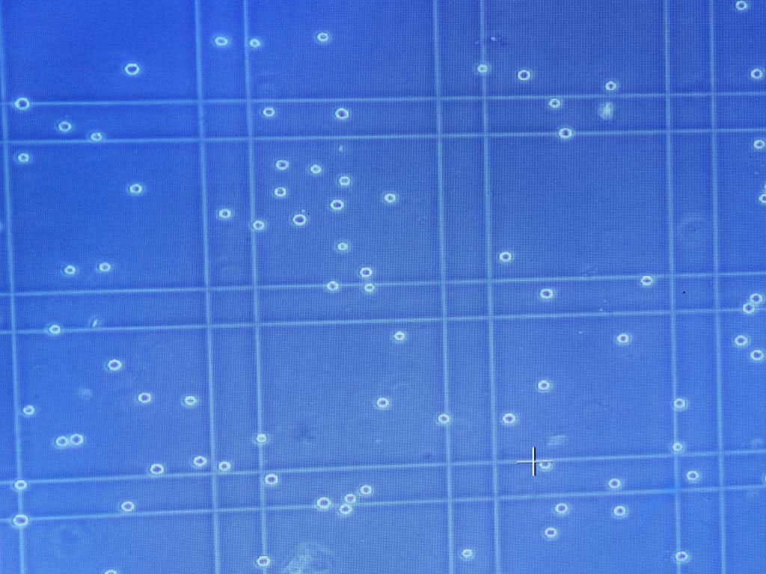
Problem
Traditional cell counting methods either involve manual counting, which is highly labor-intensive and prone to errors, or utilize expensive techniques that may risk damaging the cells.
https://www.lonzabioscience.com.au/accurate-cell-counting-using-a-hemocytometer/
https://bitesizebio.com/

Slide 4
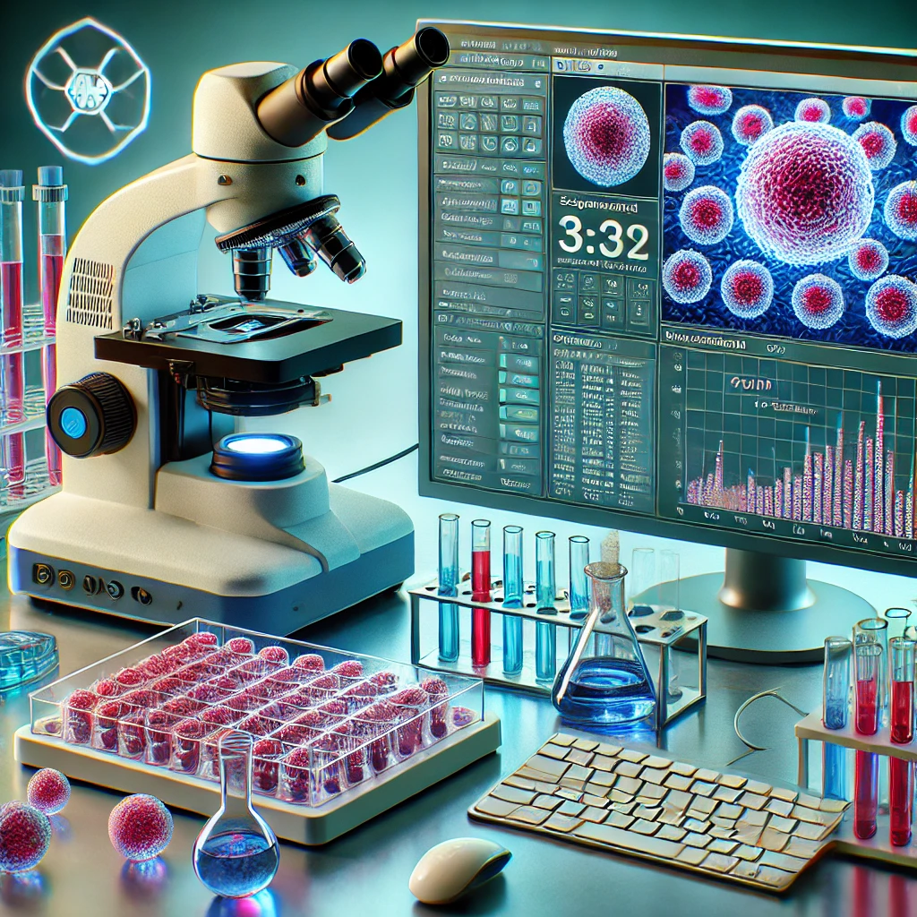
Significance
Enhances research efficiency by making cell counting a faster process.
Improves accuracy and consistency.
Has an optimized training strategy to prevent errors.
Prevents human prone errors during cell counting.
Prevents scientists from burning out during experiments.
Prevents using methods that could potentially damage the cells.
Cost effective.
Notes:
This solution is important because it will make cell counting faster making research more efficient while improving accuracy and consistency. The optimized training strategies will help prevent errors. With it being more automated, human errors and also scientist burnout that come with manual cell counting will be prevented. This will also prevent damaging cells that come with othe r methods while being cost effective.

Slide 5
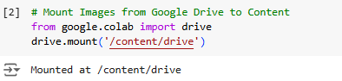
Cell 2: How to Get it to Run: Mounting the Google Drive
Purpose: To get the dataset to run, google colab needs access to the dataset through google drive.
*moved to the code to explain as it ran.

Slide 6
Cell 3: Importing the Images
Purpose (Libraries): Imports essential libraries:
os and cv2: For file handling and image processing.
numpy: For numerical operations.
train_test_split: Splits data into training and testing sets.
google.colab.drive: Accesses datasets stored on Google Drive.
Purpose (load_ground_test_truth): Reads ground truth images and extracts their corresponding cell counts from filenames. Returns image-label pairs as arrays.
Purpose (test/train): Splits the dataset into 80% training and 20% testing sets.
Normalizes images to improve model convergence and reshapes them to include a channel dimension for CNN compatibility.

Slide 7
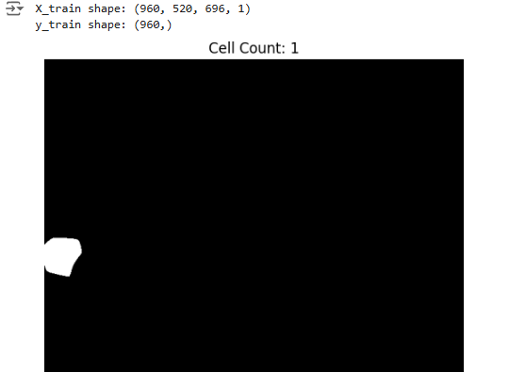
Cell 4: Testing an imported image
Purpose:
Displays a single training image and its label (cell count) for dataset verification.
Display X_train set shape and y_train set shape

Slide 8
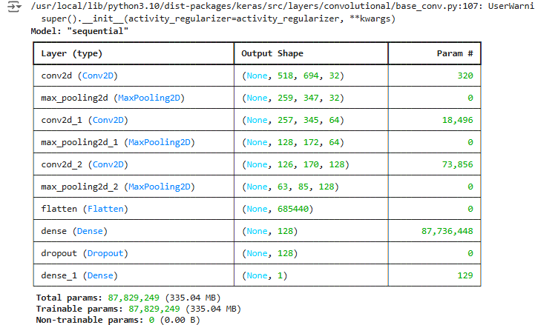
Cell 6: Define the ML model

Slide 9
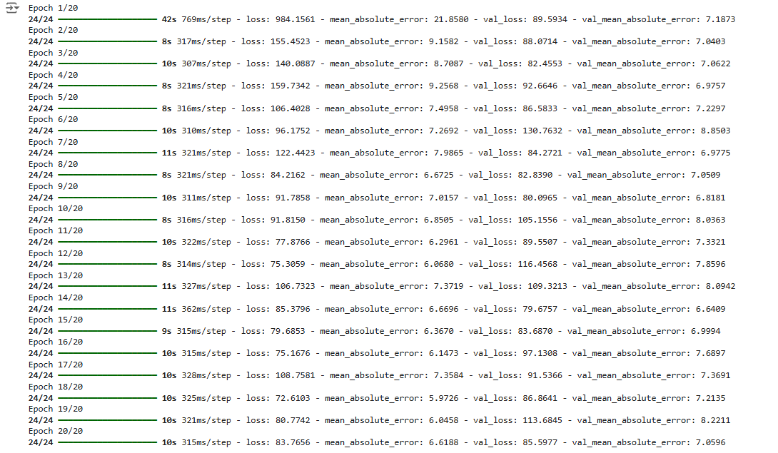
Cell 7 and 8: Training and Validating the Model

Slide 10
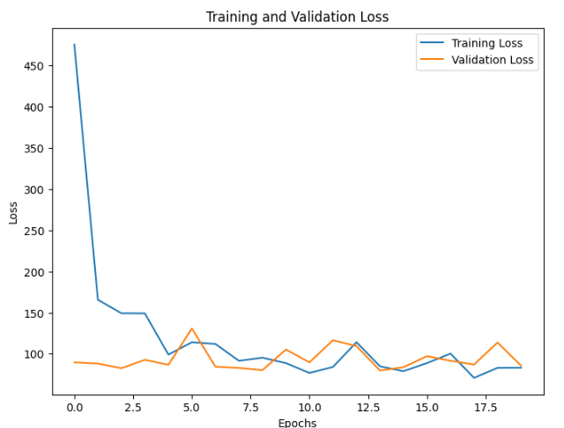
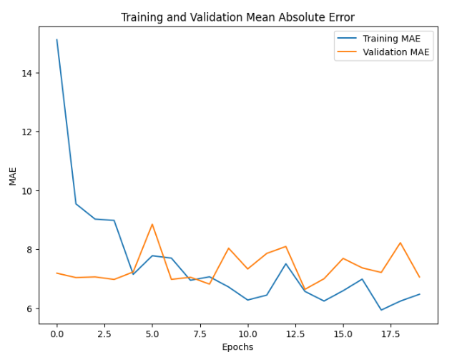
Cell 9: Visualizing the model over 20 Epochs
Purpose: Evaluates the model on the test set and prints the loss and mean absolute error (MAE). Trains the model using 80% of the training set for training and 20% for validation over 20 epochs.

Slide 11
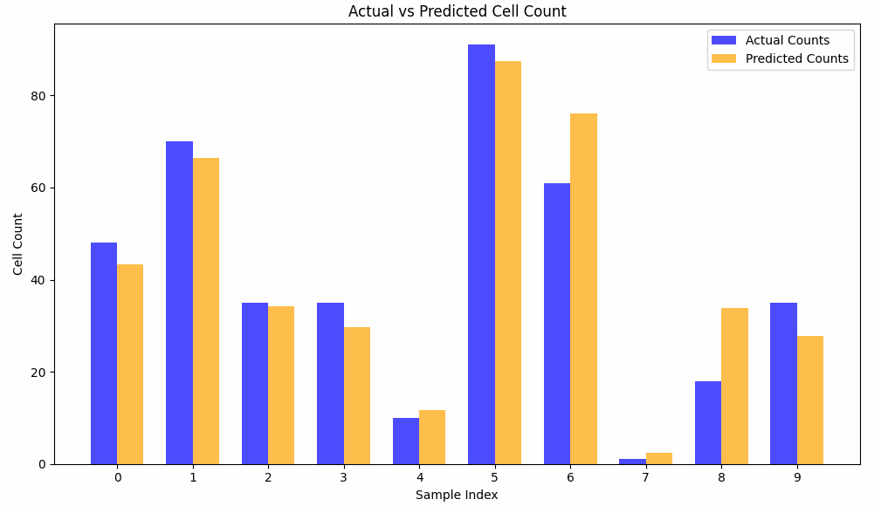
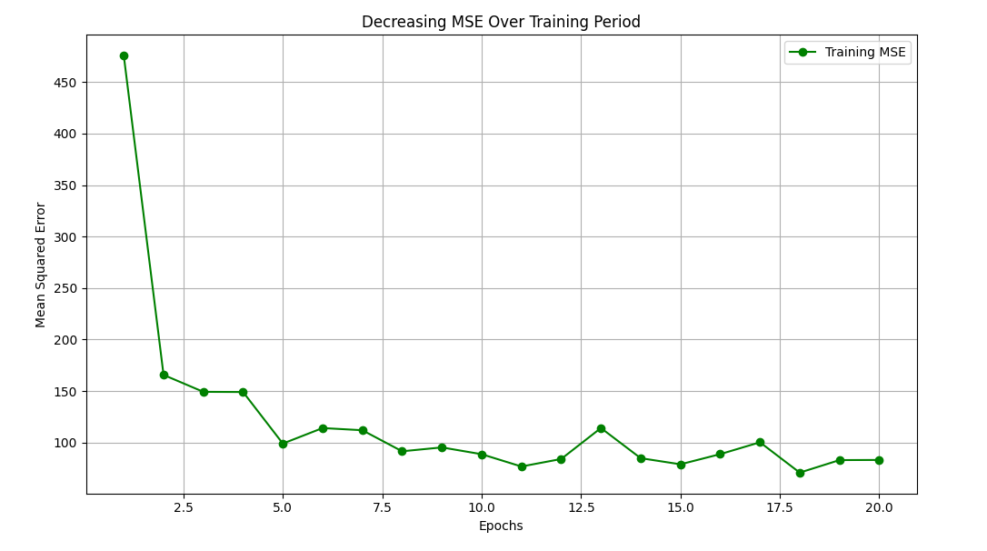
Cell 11: Visualizing the model over 20 Epochs
Compares actual cell counts and predicted values as a bar graph.
Plots the mean squared error (MSE) across epochs to visualize model improvement during training.

Slide 12

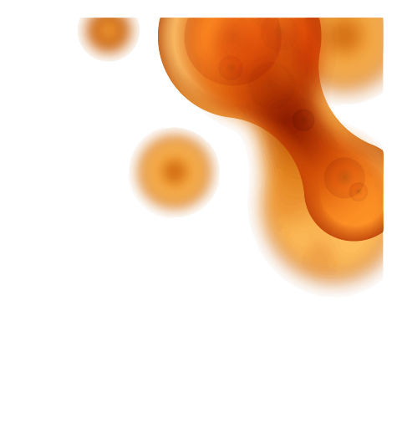
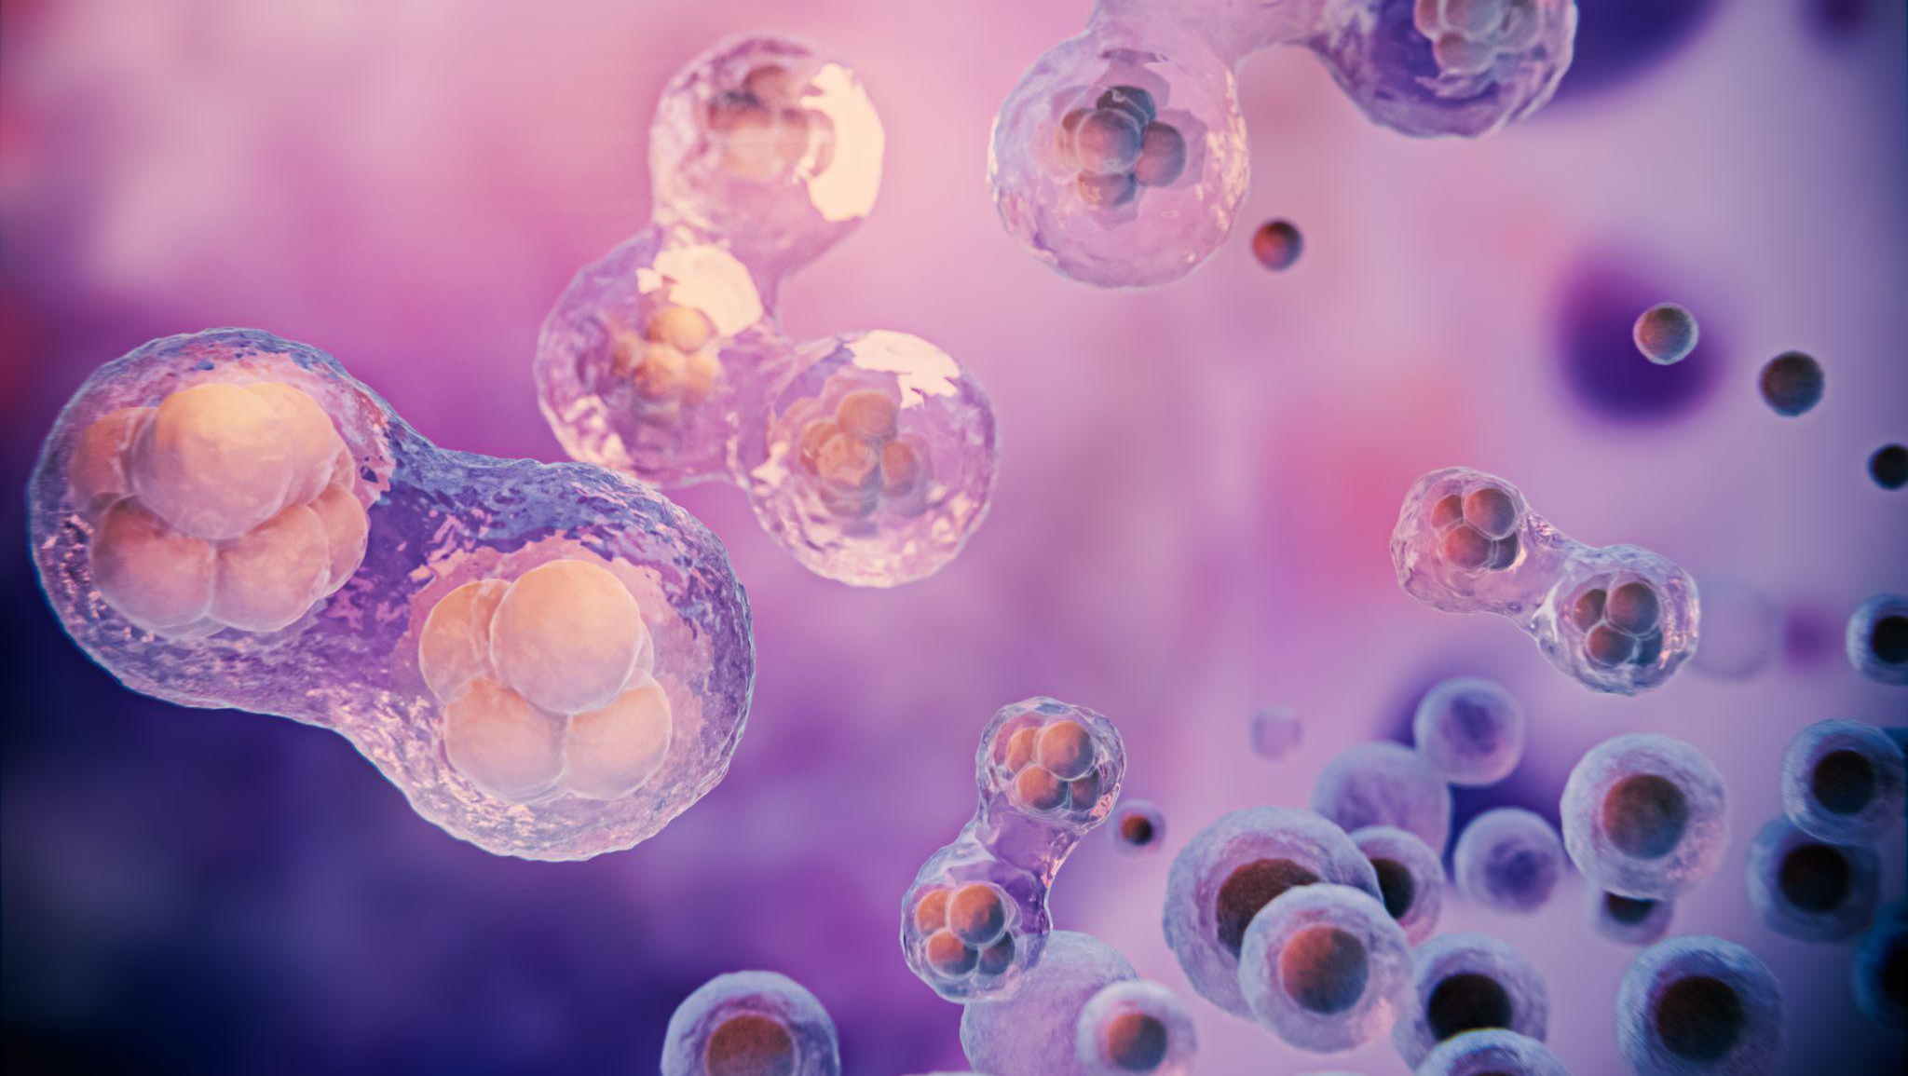
Thank you!

